Slide 1
ANN Building Blocks.
Processing of ANN depends upon the following three building blocks −
Network Topology
Adjustments of Weights or Learning
Activation Functions

Slide 2
1.Network Topology
A network topology is the arrangement of a network along with its nodes and connecting lines.
The topology of a neural network refers to the way how Neurons are associated, and it is a significant factor in network functioning and learning.
A common topology in unsupervised learning is a direct mapping of inputs to a group of units that represents categories, for example, self-organizing maps.

Slide 3
1.Network Topology
The most widely recognized topology in supervised learning is completely associated, three-layer, feedforward network (Backpropagation, Radial Basis Function Networks).
All input values are associated with all neurons in the hidden layer (hidden because they are not noticeable in the input or the output), the output of the hidden neurons are associated to all neurons in the output layer, and the activation functions of the output neurons establish the output of the entire network.
Such networks are well-known partly because hypothetically, they are known to be universal function approximators, for example, a sigmoid or Gaussian.
According to the topology, ANN can be classified as the following kinds −

Slide 4
Feedforward Network
It is a non-recurrent network having processing units/nodes in layers and all the nodes in a layer are connected with the nodes of the previous layers.
The connection has different weights upon them.
There is no feedback loop means the signal can only flow in one direction, from input to output.
It may be divided into the following two types −

Slide 5
Feedforward Network
Single layer feedforward network −
The concept is of feedforward ANN having only one weighted layer.
In other words, we can say the input layer is fully connected to the output layer.

Slide 6
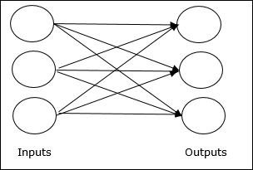
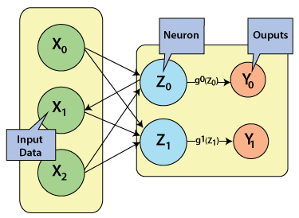
Feedforward Network

Slide 7
Feedforward Network
Multilayer feedforward network.
The concept is of feedforward ANN having more than one weighted layer.
As this network has one or more layers between the input and the output layer, it is called hidden layers.

Slide 8
Multilayer feedforward network.
The total number of layers in a neural network is the same as the total number of layers of perceptrons.
The easiest neural network is one with a single input layer and an output layer of perceptrons.
The concept of feedforward artificial neural network having more than one weighted layer.
As the system has at least one layer between the input and the output layer, it is called the hidden layer.

Slide 9
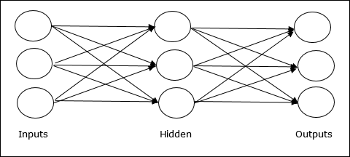
Feedforward Network

Slide 10
Feedforward Network
Feedback Network
As the name suggests, a feedback network has feedback paths, which means the signal can flow in both directions using loops.
This makes it a non-linear dynamic system, which changes continuously until it reaches a state of equilibrium.
It may be divided into the following types

Slide 11
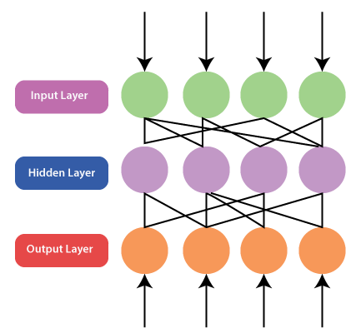
Feedback Network
Feedback Network
Recurrent networks − They are feedback networks with closed loops.
Following are the two types of recurrent networks.

Slide 12
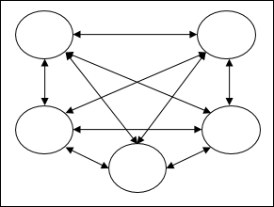
Feedback Network
Feedback Network
Fully recurrent network − It is the simplest neural network architecture because all nodes are connected to all other nodes and each node works as both input and output.

Slide 13
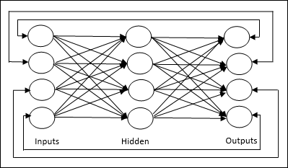
FeedBACK Network
Feedback Network
Jordan network − It is a closed loop network in which the output will go to the input again as feedback as shown in the following diagram.

Slide 14
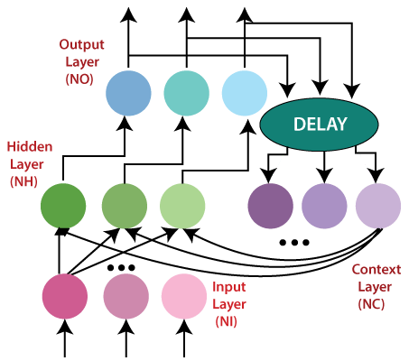
FeedBACK Network
The Jordan network refers to a simple neural structure in which only one value of the process input signal (from the previous sampling) and only one value of the delayed output signal of the model (from the previous sampling) are utilized as the inputs of the network.
In order to get a computationally basic MPC (Model Predictive Control) algorithm, the nonlinear Jordan neural model is repeatedly linearized on line around an operating point, which prompts a quadratic optimization issue.

Slide 15
2.Adjustments of Weights or Learning
Learning, in artificial neural network, is the method of modifying the weights of connections between the neurons of a specified network.
Learning in ANN can be classified into three categories namely..
supervised learning,
unsupervised learning,
and reinforcement learning.

Slide 16
1.Supervised Learning.
As the name suggests, this type of learning is done under the supervision of a teacher.
This learning process is dependent.
During the training of ANN under supervised learning, the input vector is presented to the network, which will give an output vector.
This output vector is compared with the desired output vector. An error signal is generated, if there is a difference between the actual output and the desired output vector.
On the basis of this error signal, the weights are adjusted until the actual output is matched with the desired output.

Slide 17
Here the machine or program is learning with the help of the existing data set.
We have a data set, and we assume the results of new data relying upon the behavior of the existing data sets.
It implies the existing data sets acts as a supervisor or boss to find the new data.
Example: Electronic gadgets price prediction.
The price of electronic gadgets is predicted depending on what is observed with the prices of other digital gadgets.

Slide 18
During the training of artificial neural networks under supervised learning, the input vector is given to the network, which offers an output vector.
Afterward, the output vector is compared with the desired output vector.
An error signal is produced if there is a difference between the actual output and the desired output vector.
Based on this error signal, the weight is adjusted until the actual output is matched with the desired output.

Slide 19
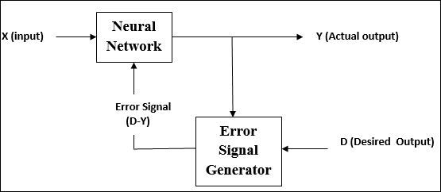
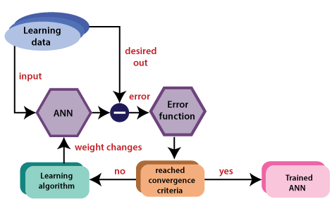
Adjustments of Weights or Learning

Slide 20
2.Unsupervised Learning.
As the name suggests, this type of learning is done without the supervision of a teacher.
This learning process is independent.
During the training of ANN under unsupervised learning, the input vectors of similar type are combined to form clusters.
The program learns by dividing the data with similar characteristics into similar groups.
When a new input pattern is applied, then the neural network gives an output response indicating the class to which the input pattern belongs.

Slide 21
In supervised learning, the data are grouped, relying upon similar characteristics.
In this situation, there are no existing data to look for direction. In other words, there is no supervisor.
During the training of the artificial neural network under unsupervised learning, the input vectors of a comparative type are joined to form clusters.
At the point when a new input pattern is implemented, then the neural network gives an output response showing the class to which the input pattern belongs.
There is no feedback from the environment about what should be the ideal output and if it is either correct or incorrect.
Consequently, in this type of learning, the network itself must find the patterns and features from the input data and the connection for the input data over the output.

Slide 22
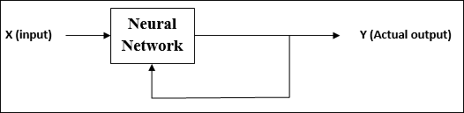
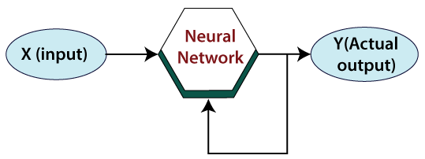
There is no feedback from the environment as to what should be the desired output and if it is correct or incorrect.
Hence, in this type of learning, the network itself must discover the patterns and features from the input data, and the relation for the input data over the output.

Slide 23
3.Reinforcement Learning
As the name suggests, this type of learning is used to reinforce or strengthen the network over some critic information.
This learning process is similar to supervised learning, however we might have very less information.
During the training of network under reinforcement learning, the network receives some feedback from the environment.
This makes it somewhat similar to supervised learning. However, the feedback obtained here is evaluative not instructive, which means there is no teacher as in supervised learning.
After receiving the feedback, the network performs adjustments of the weights to get better critic information in future.

Slide 24
Reinforcement Learning (RL) is a technique that helps to solve control optimization issues.
By using control optimization, we can recognize the best action in each state visited by the system in order to optimize some objective function.
Typically, reinforcement learning comes into existence when the system has a huge number of states and has a complex stochastic structure, which is not responsible to closed-form analysis.
If issues have a relatively small number of states, then the random structure is relatively simple, so that one can utilize dynamic programming.

Slide 25
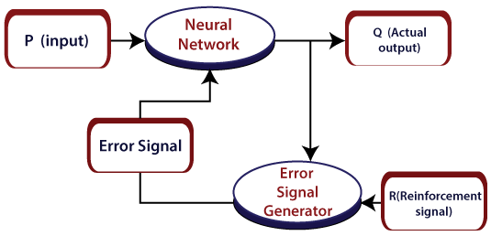
Adjustments of Weights or Learning

Slide 26
3.Activation Functions.
Activation functions refer to the functions used in neural networks to compute the weighted sum of input and biases, which is used to choose the neuron that can be fire or not.
It controls the presented information through some gradient processing, normally gradient descent.
It produces an output for the neural network that includes the parameters in the data.

Slide 27
3.Activation Functions.
Activation function can either be linear or non-linear, relying on the function it shows.
It is used to control the output of outer neural networks across various areas, such as speech recognition, segmentation, fingerprint detection, cancer detection system, etc.

Slide 28
Activation Functions.
It may be defined as the extra force or effort applied over the input to obtain an exact output.
In ANN, we can also apply activation functions over the input to get the exact output.
Followings are some activation functions of interest −
Linear Activation Function
It is also called the identity function as it performs no input editing. It can be defined as − F(X)=X
The equation of the linear activation function is the same as the equation of a straight line i.e.Y= MX+ C

Slide 29
Activation Functions.
Sigmoid Activation Function
It is of two type as follows −
Sigmoid function refers to a function that is projected as S - shaped graph. A = 1/(1+e-x)
Binary sigmoidal function −
This activation function performs input editing between 0 and 1.
It is positive in nature. It is always bounded, which means its output cannot be less than 0 and more than 1.
It is also strictly increasing in nature, which means more the input higher would be the output. It can be defined as

Slide 30
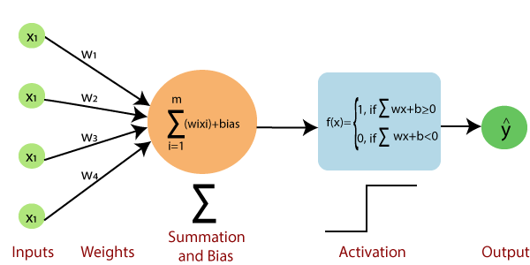
Activation Functions.

Slide 31
How Neural Networks work.
Neural Networks are complex systems with artificial neurons.
Artificial neurons or perceptron consist of:
Input
Weight
Bias
Activation Function
Output

Slide 32
How Neural Networks work.
The neurons receive many inputs and process a single output.
Neural networks are comprised of layers of neurons.
These layers consist of the following:
Input layer
Multiple hidden layers
Output layer

Slide 33
How Neural Networks work.
The input layer receives data represented by a numeric value.
Hidden layers perform the most computations required by the network.
Finally, the output layer predicts the output.
In a neural network, neurons dominate one another.
Each layer is made of neurons.
Once the input layer receives data, it is redirected to the hidden layer. Each input is assigned with weights.

Slide 34
How Neural Networks work.
The weight is a value in a neural network that converts input data within the network’s hidden layers.
Weights work by input layer, taking input data, and multiplying it by the weight value.
It then initiates a value for the first hidden layer.
The hidden layers transform the input data and pass it to the other layer.
The output layer produces the desired output.

Slide 35
How Neural Networks work.
The inputs and weights are multiplied, and their sum is sent to neurons in the hidden layer.
Bias is applied to each neuron.
Each neuron adds the inputs it receives to get the sum.
This value then transits through the activation function.

Slide 36
How Neural Networks work.
The activation function outcome then decides if a neuron is activated or not.
An activated neuron transfers information into the other layers.
With this approach, the data gets generated in the network until the neuron reaches the output layer.

Slide 37
How Neural Networks work.
Another name for this is forward propagation.
Feed-forward propagation is the process of inputting data into an input node and getting the output through the output node.
Feed-forward propagation takes place when the hidden layer accepts the input data.
Processes it as per the activation function and passes it to the output.
The neuron in the output layer with the highest probability then projects the result.

Slide 38
How Neural Networks work.
If the output is wrong, backpropagation takes place.
While designing a neural network, weights are initialized to each input.
Backpropagation means re-adjusting each input’s weights to minimize the errors, thus resulting in a more accurate output.

Slide 39
Group Discussion.
Activity: Class Discussion:
How supervised and reinforced is used in modern neural networks systems.
Cite example
Python code for each example.

Slide 40
Q&A

